Slide 1



L1&L2 KPI Dashboard
View in Power BI
Last data refresh:
6/1/2023 6:31:56 AM UTC
Downloaded at:
6/1/2023 6:37:47 AM UTC

Slide 2
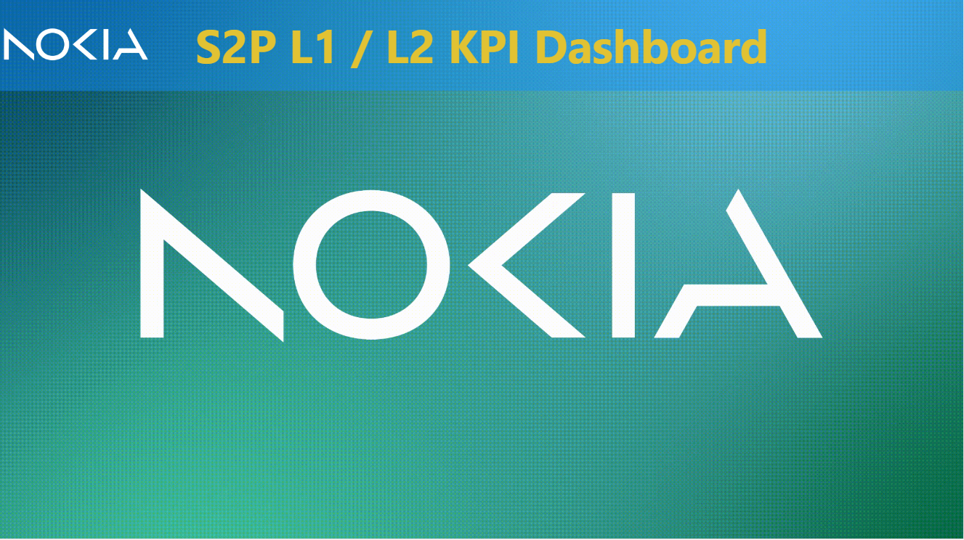
KPI Dashboard
Notes:
actionButton
No alt text provided
image
No alt text provided

Slide 3
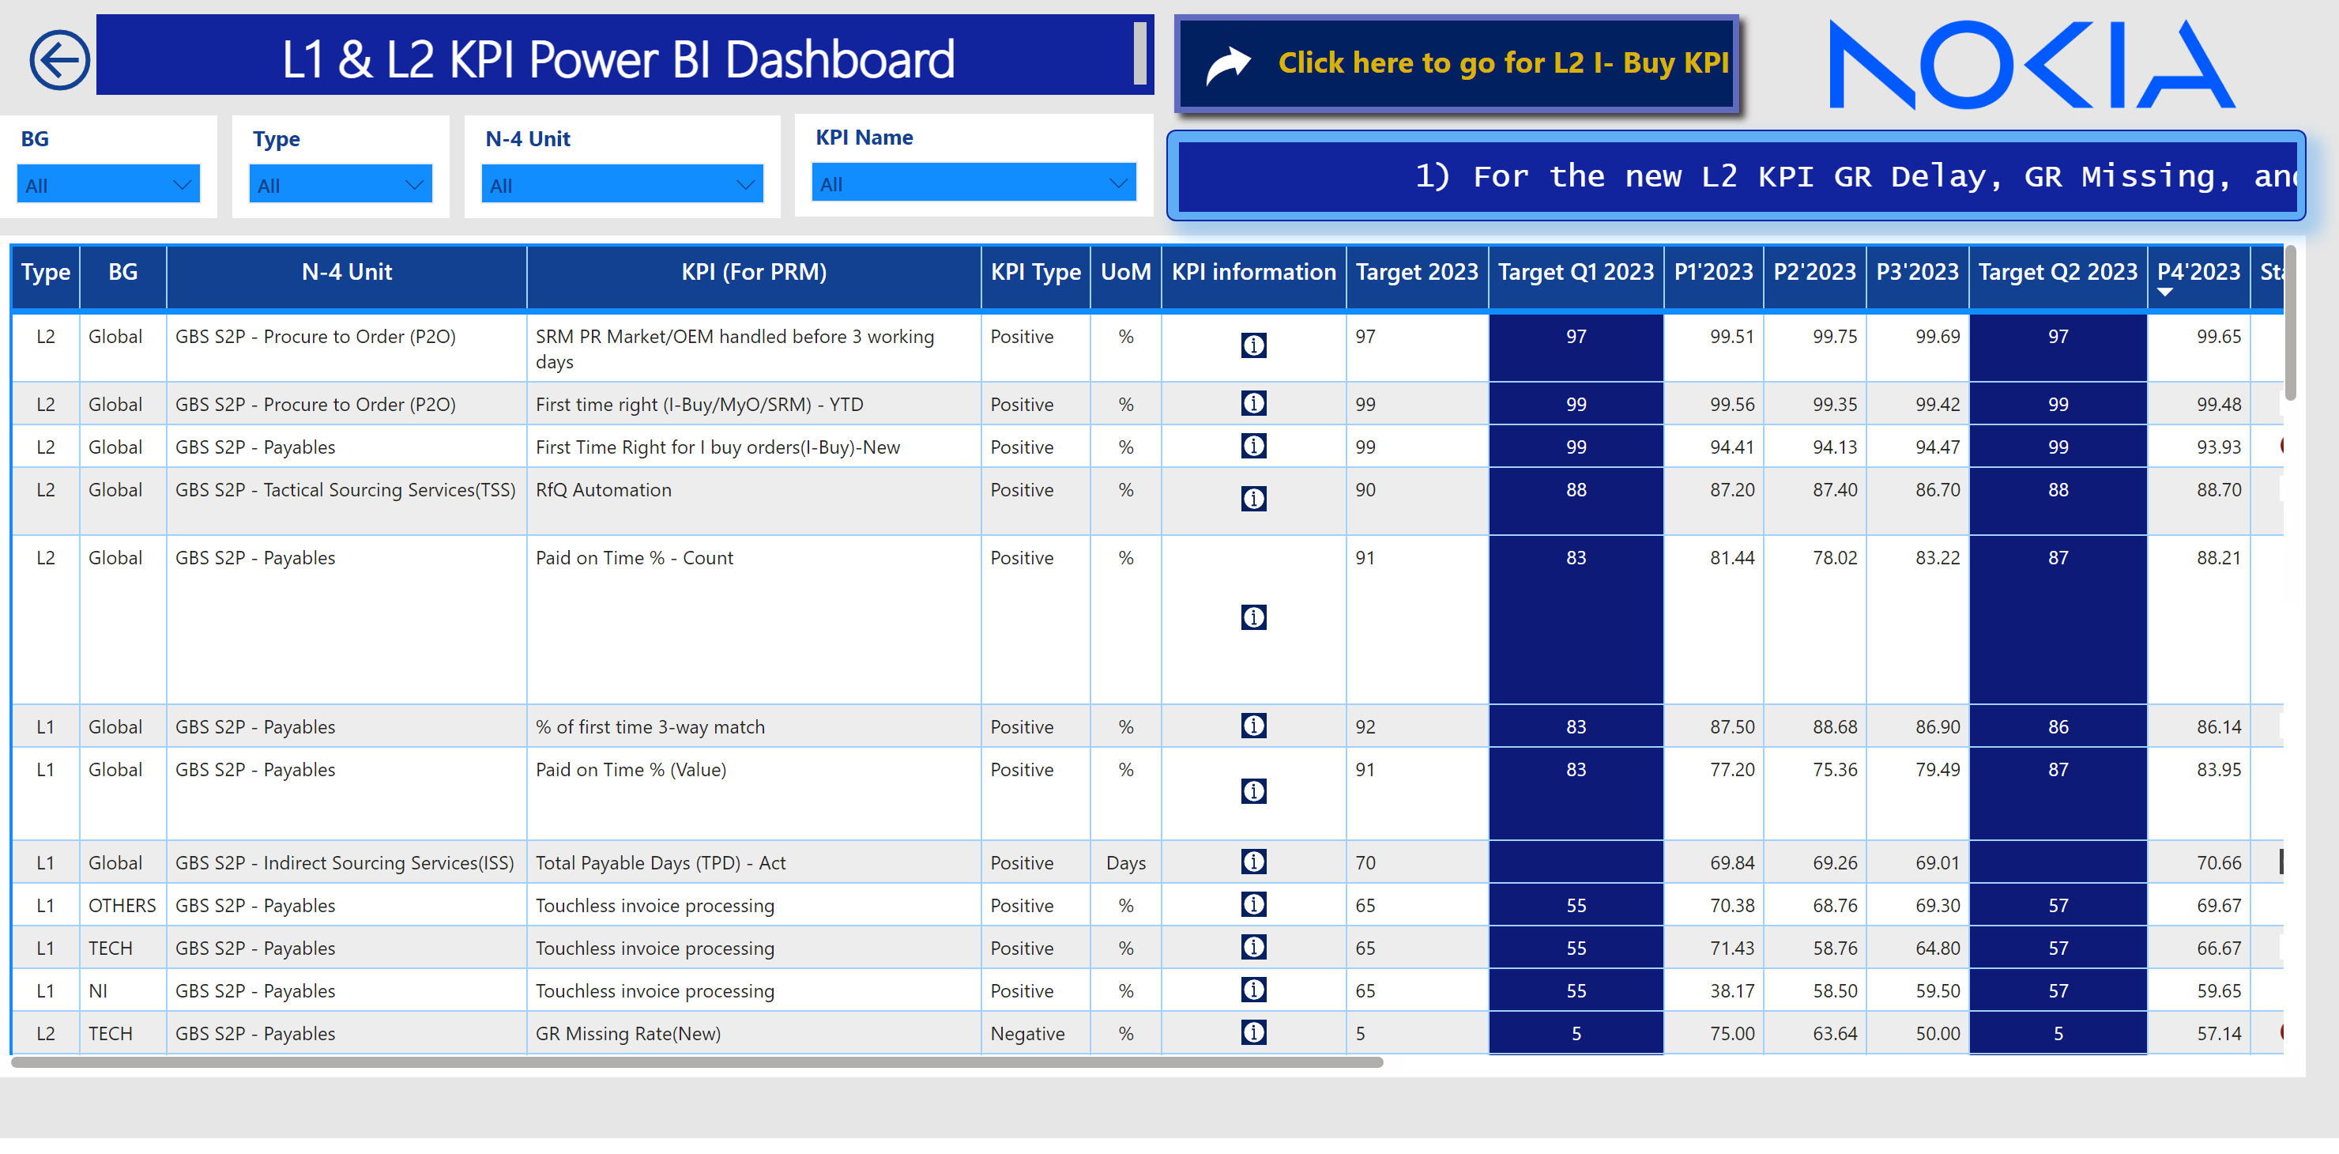
S2P KPI View L1/L2
Notes:
L1/L2
No alt text provided
L1/L2
No alt text provided
l1/l2
No alt text provided
l1/l2
No alt text provided
textbox
No alt text provided
ScrollingTextVisual1448795304508
No alt text provided
actionButton
No alt text provided
slicer
No alt text provided
tableEx
No alt text provided
slicer
No alt text provided
slicer
No alt text provided
textbox
No alt text provided
textbox
No alt text provided
slicer
No alt text provided
Button
No alt text provided
L1/L2
No alt text provided
L1/L2
No alt text provided
L1/L2
No alt text provided
L1/L2
No alt text provided
L1/L2
No alt text provided
image
No alt text provided
L1/L2
No alt text provided

Slide 4
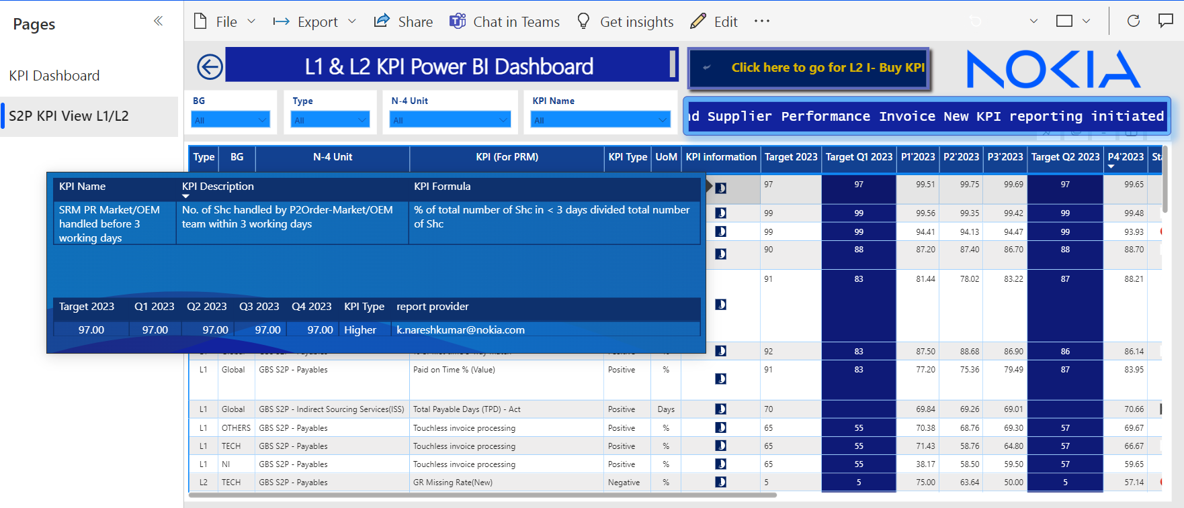
S2P KPI View L1/L2
Notes:
L1/L2
No alt text provided
L1/L2
No alt text provided
l1/l2
No alt text provided
l1/l2
No alt text provided
textbox
No alt text provided
ScrollingTextVisual1448795304508
No alt text provided
actionButton
No alt text provided
slicer
No alt text provided
tableEx
No alt text provided
slicer
No alt text provided
slicer
No alt text provided
textbox
No alt text provided
textbox
No alt text provided
slicer
No alt text provided
Button
No alt text provided
L1/L2
No alt text provided
L1/L2
No alt text provided
L1/L2
No alt text provided
L1/L2
No alt text provided
L1/L2
No alt text provided
image
No alt text provided
L1/L2
No alt text provided

Slide 5
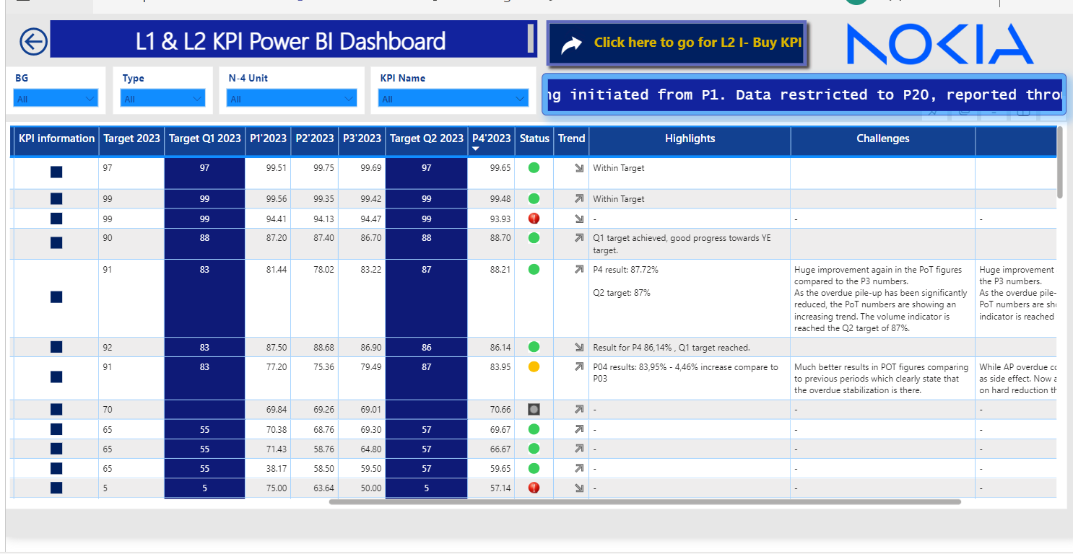
S2P KPI View L1/L2
Notes:
L1/L2
No alt text provided
L1/L2
No alt text provided
l1/l2
No alt text provided
l1/l2
No alt text provided
textbox
No alt text provided
ScrollingTextVisual1448795304508
No alt text provided
actionButton
No alt text provided
slicer
No alt text provided
tableEx
No alt text provided
slicer
No alt text provided
slicer
No alt text provided
textbox
No alt text provided
textbox
No alt text provided
slicer
No alt text provided
Button
No alt text provided
L1/L2
No alt text provided
L1/L2
No alt text provided
L1/L2
No alt text provided
L1/L2
No alt text provided
L1/L2
No alt text provided
image
No alt text provided
L1/L2
No alt text provided

